Slide 1
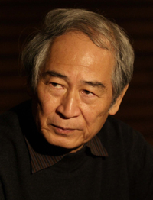
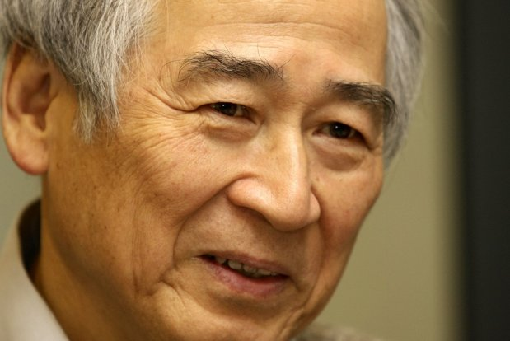
Tadashi-Suzuki
The one and only

Slide 2
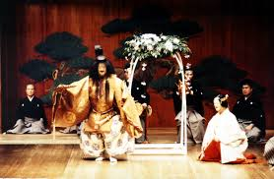
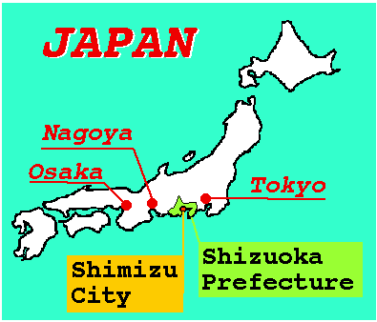
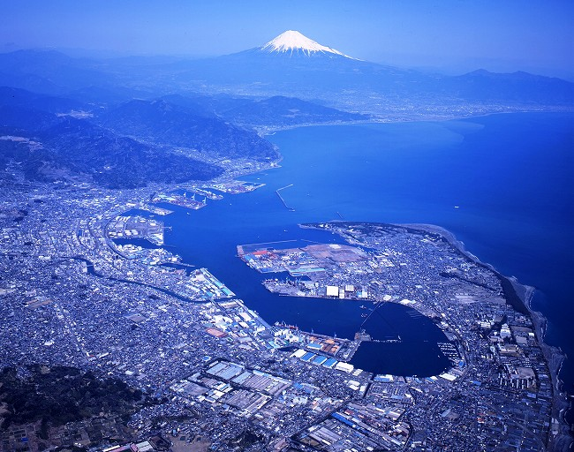
Background
June 20, 1939 (currently 76).
Shimizu Japan.
His interests turned around Noh and Kabuki (japanese style)
He was inspired by a Noh performance he saw in France.

Slide 3
Work
Theatre director, writer and philosopher.
Founder and director of the Suzuki Company (great SCOT).
Organizer of first theatre festival (Toga festival).
Creator of the Suzuki Method acting of training.
‘’On the Dramatic Passions’’, ‘’The Trojan Women’’, ‘’Dionysus’’, ‘’King Lear’’, ‘’Madame de Sade’’ and many others.
.

Slide 4
The Suzuki Method of acting
A collection of exercises that attempts the disorientation of one’s centre of gravity, disrupt the breath and challenge the limits of physical and emotional experience.
Stillness and motion are two basic components of method: ‘’Look for the movement in stillness, for the stillness in movement’’.

Slide 5
Suzuki’s ideology
Spoken words are directly tied to human gesture, and the actor’s goal is to convince the audience of something.
Foot movements in order to please the audience.
‘’Wearing shoes makes the actor’s lose their feet’’.
Performance begins when you are feeling the roots from the ground.

Slide 6
Suzuki’s focus/goals
Bring people back to animal energy (or instincts).
Reveal difficulties of human nature through performance.

Slide 7
Goals of actor during training
Understand the ways which the feet contact the floor.
Breath through the nose.
When stomping, send the energy through the floor into the ground, not onto it.
Upper body free but strong.
Constant focus and awareness.
Maintain a blank expression.
Lower body constantly engaged.

Slide 8
Importance of centre of gravity
It is like a well of power. If used wisely, you can access endless energy.
It must be low and the energy must be controlled.
Permitting physical strain will permit psychological strain which will bring big emotions. alive.

Slide 9
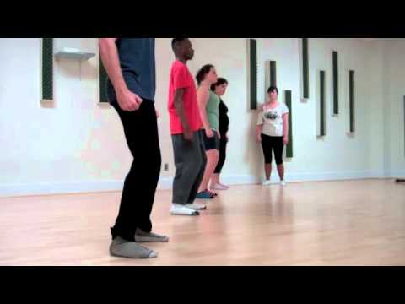
Ten ways of walking

Slide 10
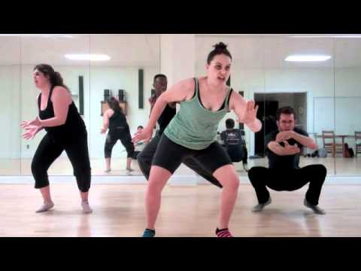
Standing Statues

Slide 11
Actor’s feedback on Tadashi’s Method
Emphasis on how it made brain connect to body.
Helped them find their centre and connect to their energy.
Made them aware of their breathing even when speaking.
Took them out of their comfort zone.

Slide 12
Sources
https://prezi.com/edqccdhhrtnm/tadashi-suzukis-actor-training-technique/
http://dlibrary.acu.edu.au/staffhome/siryan/academy/theatres/suzuki,%20t.htm
https://prezi.com/uyofwu74079d/tadashi-suzuki/
https://en.wikipedia.org/wiki/Tadashi_Suzuki
http://www.scot-suzukicompany.com/en/profile.php

