Slide 1
“Dialogue is democracy”
Augusto Boal

Slide 2
Augusto Boal and the
Theatre of the Oppressed
Jennifer Fernandez Owsianka

Slide 3
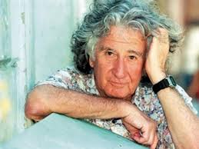
The Practitioner
Brazilian director and actor
born in Rio de Janeiro
founded the Arena Theatre in 1956
1971 arrested+tortured
exiled in Argentina
Augusto Boal

Slide 4
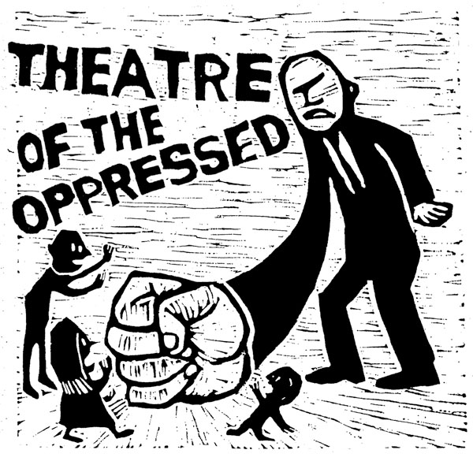
Origins
Military dictatorship
1964 - 1985
Human rights lost
Latin America
Arrestations
Torture
Murders

Slide 5
What is it?
“Rehearsal for the revolution”
To transform spectators into actors
search for liberation
exploration of reality
“The Theatre is a weapon, and it is the people who should wield it”
Augusto Boal
Theatre of the Oppressed

Slide 6
Liberation from oppression
The Spect-actor
voice
actors of change
power of actor
unprivileged/poor
empowerment
take the stage
explore their problems
imagine solutions
freedom

Slide 7
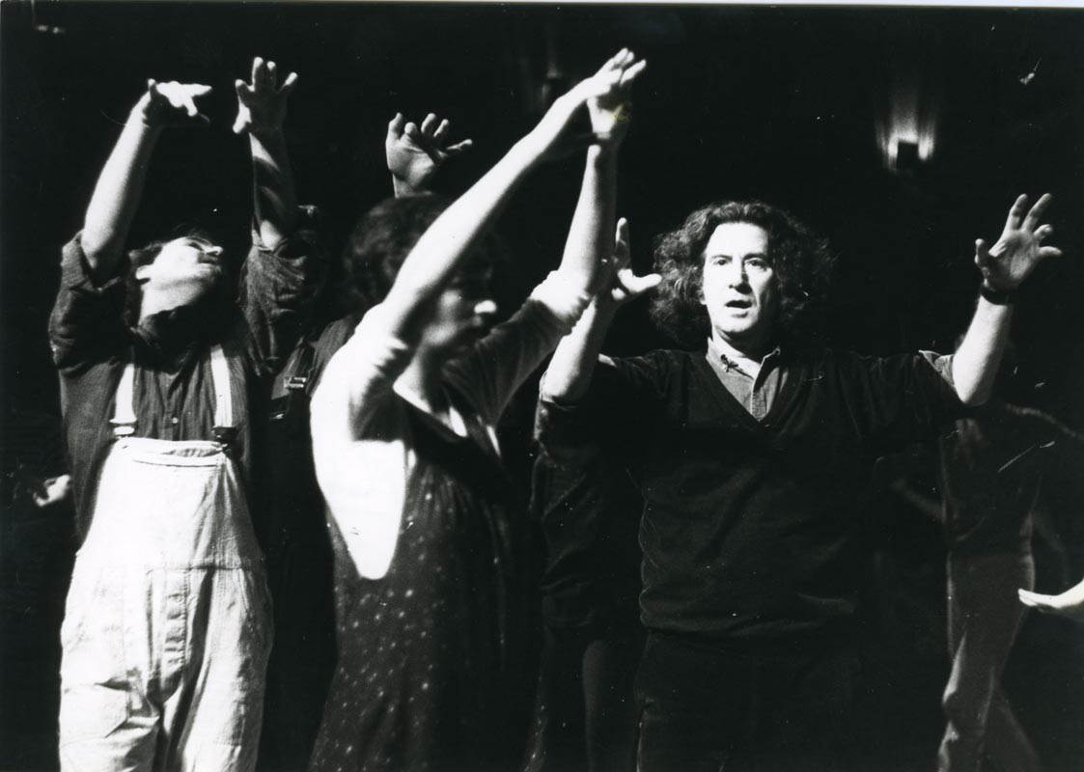
Components of TOTO
Forum theatre
invisible theatre
legislative theatre
Rainbow of desire

Slide 8
“While some people make theater, we are all theatre”
Augusto Boal

Slide 9
Sources
Theatre Studies:the basics by Robert Leach
Performance Studies by Richard Schechner
Theatre of the Oppressed by Augusto Boal
http://ptoweb.org/aboutpto/a-brief-biography-of-augusto-boal/
https://brechtforum.org/abouttop
http://institutoaugustoboal.org/
Games for Actors and Non-actors by Augusto Boal

