Slide 1
Jacques Lecoq
“In life I want my students to be alive and on stage I want them to be artists”

Slide 2
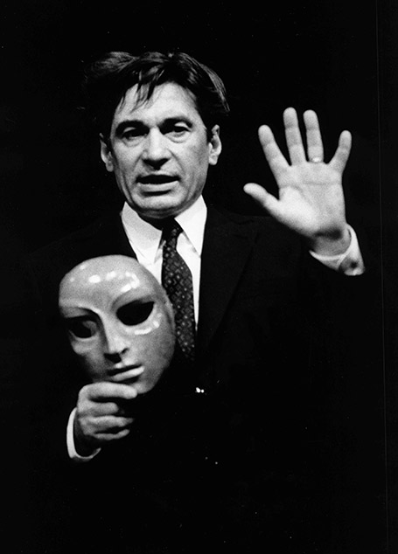
Who was he?
Born 15th December 1921 in Paris
Saw movement/mime as a form of expression and protest
1956 he founded his own theatre school in Paris called the Ecole Internationale de Theatre.

Slide 3
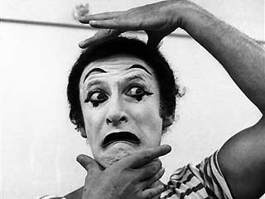
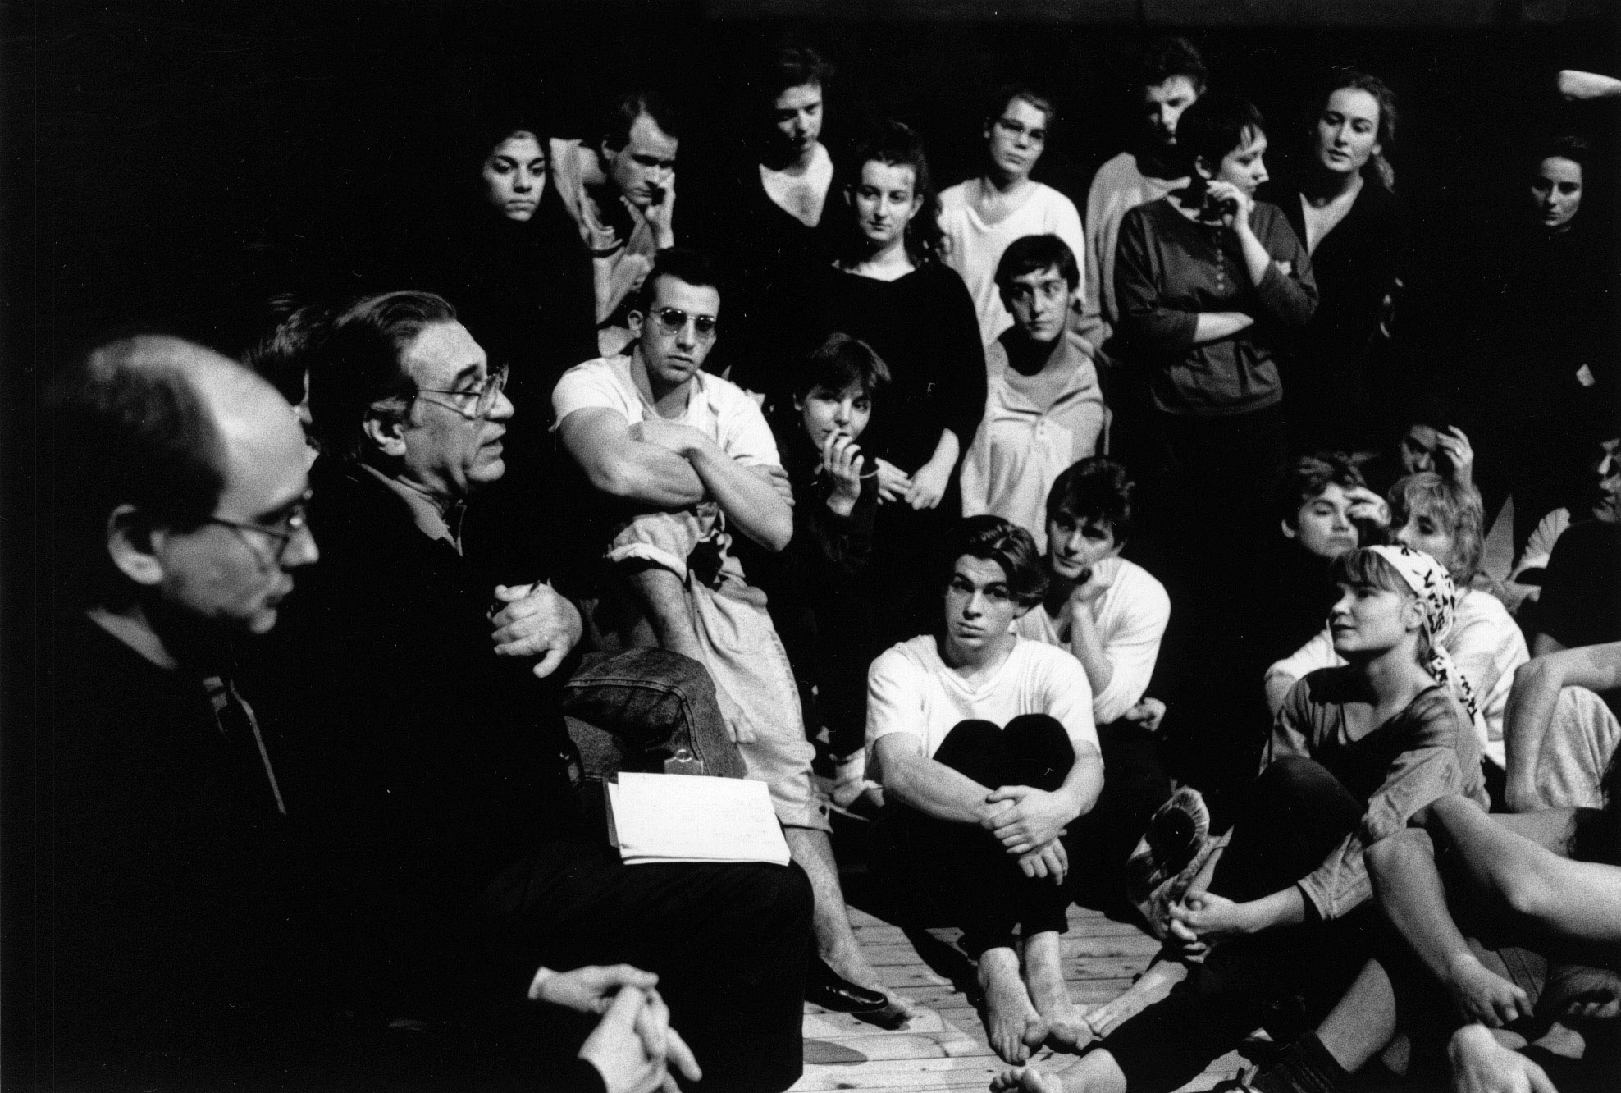
What was his theatre style
5 main principles:
Masked performance
Tragedy
Melodrama
Commedia dell’arte
Clowning

Slide 4
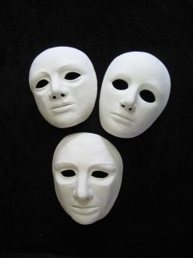
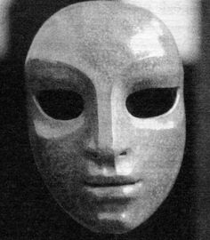
Masked performance
Began training using the neutral mask:
It would allow the students to be able to fully connect with their movements
Once they mastered the neutral mask they could move onto smaller and more intricate masks .

Slide 5
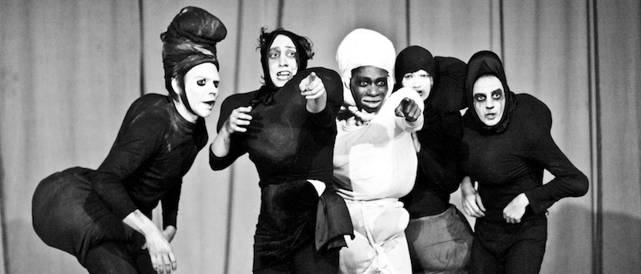
Tragedy-Chorus and Hero
“Tragedies cannot be improvised, they require an author”
Chorus are part of the play, but not involved in the action
Tragic downfall

Slide 6
Melodrama- Grand Emotions
“We aim to produce real tears. Now this can only be achieved if the characters really do believe in the absolute values, and with such conviction that they are willing to sacrifice themselves”

Slide 7
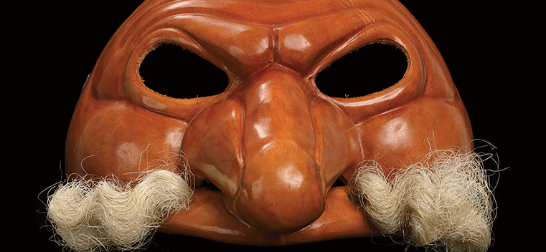
Commedia Dell’ Arte- The Human Comedy
Highlights human greed, cunningness, desires, stupidity etc
It’s pushed to the extreme and therefore it becomes comical
Half masks are often used in this style

Slide 8
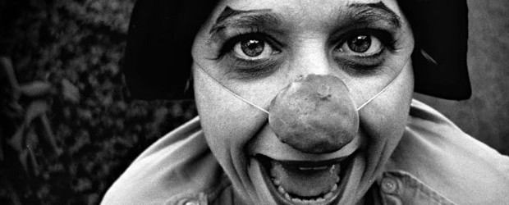
Clowning
“We are all clowns, we think we are beautiful, clever and strong, whereas we all have a weaknesses, our ridiculous side which can make people laugh when we allow it to express itself. “
clowns work off the audience, reacting to their emotions and expressions
exaggeration of basic movements eg walking, drinking, swinging arms

Slide 9
Conclusion
Regarded as one of the most influential teachers of physical theatre in the 20th century
Believed in freedom of body and movement-expression is key
Techniques and beliefs are still recognised and used today

Slide 10
Theatre in practise
https://www.youtube.com/watch?v=Ez1oVZ1iKT0

Slide 11
sources
http://www.telerama.fr/scenes/jacques-lecoq-le-gourou-cache-d-avignon,83982.php
Lecoq, Jaques. The Moving Body. Suffolk: Methuen Publishing Limited, 2000. Print.
http://meryns-drama-logblog.tumblr.com/post/15615107364/jacques-lecoq
http://commediaschool.com/
http://www.telerama.fr/scenes/jacques-lecoq-le-gourou-cache-d-avignon,83982.php
https://www.pinterest.com/pin/360076932682926348/
http://www.northwestern.edu/magazine/winter2013/campuslife/collections-behind-the-mask.html

