Slide 1
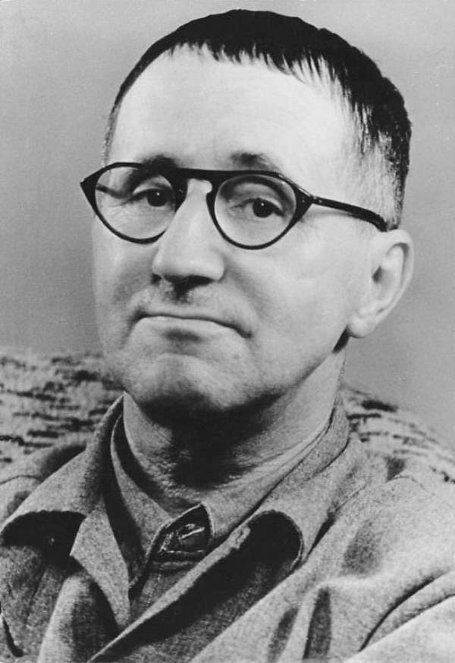
Bertold Brecht
“Art is not a mirror with which to reflect reality but a hammer with which to shape it.”

Slide 2
Born in Germany 1898
He founded the Berliner Ensemble in 1949.
He was strongly influenced by the political and cultural ideas associated with Marxism

Slide 3
Roots of Brecht’s theatre
His theatre and theory is energetic
The Bible
emphasis on ordinary people offered Brecht a sense of how to combine the ordinary with the sublime (Unwin and Jones)
Aristotle
The classical world
writers of Ancient Rome- supplied him with an example of a sophisticated society
Shakespeare and his Contemporaries

Slide 4
Theories- Alienation Effect
It occurs when the audience is encouraged to question its preconceptions and look at the familiar in a new and different way- making it strange.
“Aiming not to put his audience into a trance, he must not go into a trance himself.” . - Brecht
The acting must come across as if it has quotations marks around it.
The actor must present each moment with clarity. He also has to demonstrate his own attitude to what is being shown.
the use of the third person ” he said… she said”, is used in rehearsals and may be an option for the performance.
To highlight important moments, the actors narrate the other characters decision ” instead of responding like this, he responded like that.”

Slide 5
Epic theatre
The wanted distances between the introduction of songs, the caption in stage décor and the gestural conventions
Epic theatre is unemotional
characters grow before the spectator
The resetting of props, scenery and costume changes have to be seen by the audience

Slide 6
Gestus
Gestus refers to the embodiment of the social relationship.
The overall attitude of society is portrayed through this technique.
The text is set against the action
There is no scenery.
Unconnected scenes follow up form each other.
“Epic theatre is gestural.”
building block of his productions
It means presenting action with quotations marks around it

Slide 7
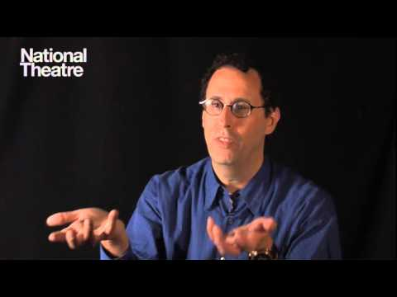

Slide 8
References
Bbc.co.uk,. 'BBC Bitesize - GCSE Drama - Epic Theatre And Brecht - Revision 1'. N.p., 2015. Web. 13 Nov. 2015.
Cs.brandeis.edu,. 'The Influence Of Brecht'. N.p., 2015. Web. 12 Nov. 2015.
Dictionary.com,. 'The Definition Of Marxism'. N.p., 2015. Web. 12 Nov. 2015.
Unwin, Stephen, and Julian Jones. The Complete Brecht Toolkit. London: Nick Hern Books, 2014. Print.
Wikipedia,. 'Bertolt Brecht'. N.p., 2015. Web. 13 Nov. 2015.
YouTube,. 'An Introduction To Brechtian Theatre'. N.p., 2015. Web. 13 Nov. 2015.

